Slide 1
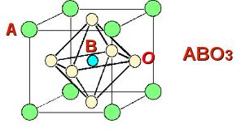
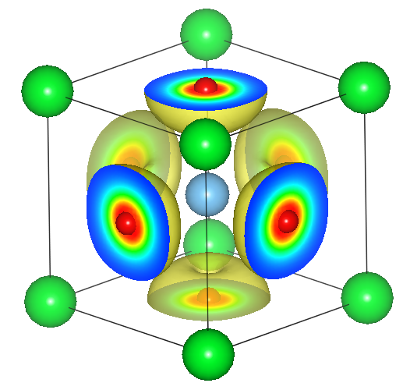
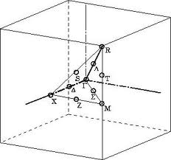
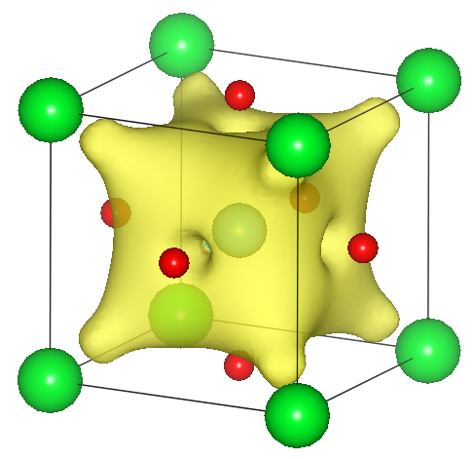
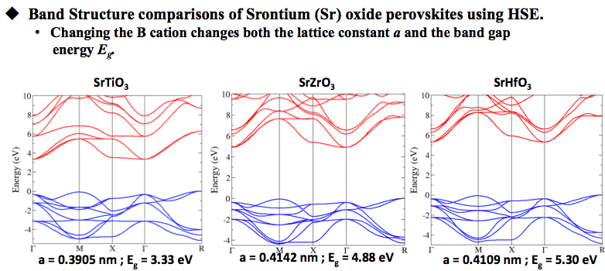
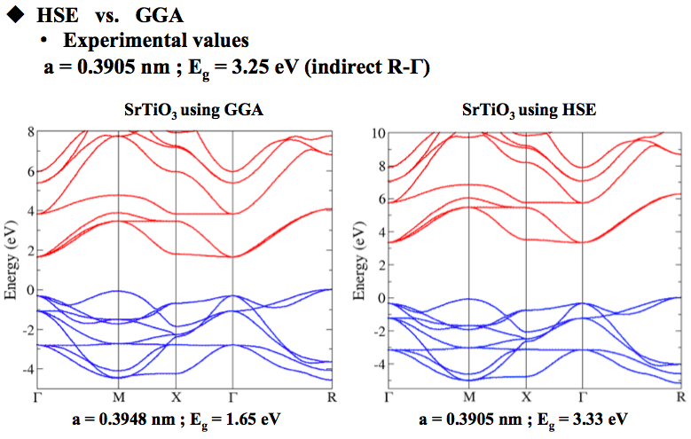
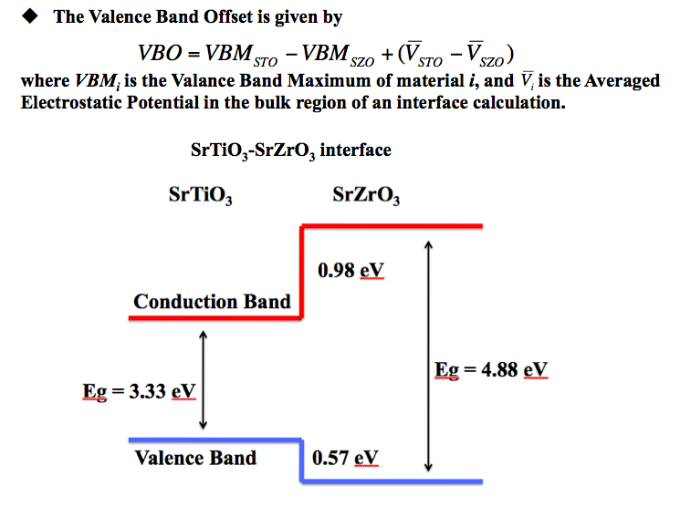
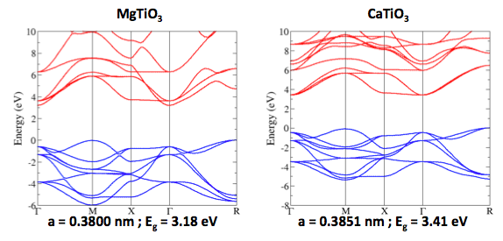
First Principles Calculations of Complex Oxide Perovskites
David-Alexander Robinson Sch., Theoretical Physics, The University of Dublin, Trinity College
Dr. Anderson Jonotti, Prof. Chris Van de Walle
Computational Materials Group, Materials Department, University of California Santa Barbara
Introduction
Theory
Complex Oxide Perovskite Semiconductors of the form ABO₃
A = Mono-, Di- or Trivalent element; Li, K, Mg, Ca, Sr, Ba, Sc, Y, La, Gd
B = Transition Metal cation; Ti, Zr, Hf, Y, Nb, Ta or; Al, Ga, In
All have the lattice constant of a ≈ 0.4nm in a pseudo-cubic form.
Despite recent progress in the epitaxial growth of complex
hetrostructures important basic parameters are still unknown
Electronic band structure, band gaps and band alignments.
Implications?
Determine from first principles basic parameters for the simulation and design of device hetrostructures based on complex oxides.
Novel electronic materials.
High power electronics.
Solve the many-electron quantum mechanical equations for the electronic structure of solids.
Hartree-Fock
The many-electron wavefunction is written as an anti-symmetric linear combination of single electron wavefunctions.
Overestimates the band gaps.
Density Functional Theory (DFT), Local Density Approximation (LDA)
Replaces the many-electron problem with a single-particle in an effective potential.
Provides an excellent description of the ground-state properties,
Accurate description of structural parameters.
But severly underestimates the band gaps.
Hybrid Functionals
Mix the Hartree-Fock with LDA exchange potential.
Screened hybrid functional of Heyd-Scuseria-Ernzerhof (HSE).
Improves the description of structural parameters.
Accurate description of electronic structure and band gaps.
An Oxide Perovskite ABO₃
Computational Details
DFT-LDA and HSE hybrid functional as implemented in the VASP code.
Projector Augmented Wave (PAW) potentials to represent the interactions between the valance electrons and the inert ion cores.
Supercells, perodic boundary conditions, plane wave basis set.
A special k-point mesh is used for integrations over the first Brillouin zone.
The calculations are preformed on super computer clusters.
SrTiO₃
Vienna Ab-initio Simulation Package (VASP) code
An Iterative method.
VASP works to minimise the energy of the system by filling up electron bands and
relaxing the lattice constant in turn.
High Performance Computing
California NanoSystems Institute (CNSI), UCSB.
Lattice, Guild and Knot clusters.
Ranger and Lonestar, Texas Advanced Computing Center, U Texas.
Computer Programming
Linux, bash, VI, XMGrace
Valance band
maximum
Conduction band
minimum
Points of high symmetry
for a simple cubic lattice
Results
The electronic properties were calculated for a range of complex oxide perovskites
Crystal | a (nm) [GGA] | a (nm) [HSE] | E_{g} (eV) [GGA] | E_{g} (eV) [HSE] | E_{g} diff (eV)
BaTiO₃ | 0.4038 | 0.3993 | 1.54 | 3.18 | 1.64
BaZrO₃ | 0.4251 | 0.4228 | 2.99 | 4.51 | 1.51
CaTiO₃ | 0.3896 | 0.3851 | 1.70 | 3.41 | 1.71
GdAlO₃ | 0.3726 | 0.3684 | 2.90 | 4.33 | 1.43
GdGaO₃ | 0.3843 | 0.3796 | 2.81 | 4.23 | 1.42
LaAlO₃ | 0.3810 | 0.3777 | 3.49 | 4.89 | 1.39
LaGaO₃ | 0.3928 | 0.3874 | 3.34 | 4.75 | 1.41
MgTiO₃ | 0.3851 | 0.3800 | 1.60 | 3.18 | 1.58
ScAlO₃ | 0.3646 | 0.3606 | 1.42 | 2.86 | 1.44
SrTiO₃ | 0.3948 | 0.3905 | 1.65 | 3.33 | 1.69
SrZrO₃ | 0.4142 | 0.4142 | 3.18 | 4.88 | 1.70
YAlO₃ | 0.3718 | 0.3681 | 2.80 | 4.36 | 1.56
Comparisons were made between plots obtained GGA and HSE.
Mg s
Ca s
Summary and Conclusions
Acknowledgements
Daniel Steiauf, John Lyons, Cyrus Dreyer, Luke Gordon and all the other members of the Van de Walle Computational Materials Group.
Dr. Charles Patterson, The School of Physics, The University of Dublin,
Trinity College and the SFI.
This work was partially funded by the UCSB CISEI internship program
through the NSF grants DMR05-20415 and NSF DMR06-49312.
The electronic bandstructure of cubic perovskites were determined from
first principles.
The valence bands of oxide perovskite are composedmostly of oxygen p-states
The conduction bands are determined by the B-cation orbitals.
The A cation can also contribute to the conduction band, as seen in MgTiO₃.
The use of hybrid functionals increase the band gaps by 1.54±0.16 eV.
Most of the band offsets are determined by the conduction bands.

