Slide 1
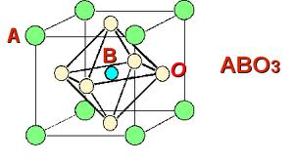
First-Principle Calculations of Oxide Perovskite Semiconductors
David-Alexander Robinson Sch., Trinity College Dublin
Dr. Anderson Janotti
Prof. Chris Van de Walle
Computational Materials Group
Materials Research Laboratory, UCSB

Slide 2
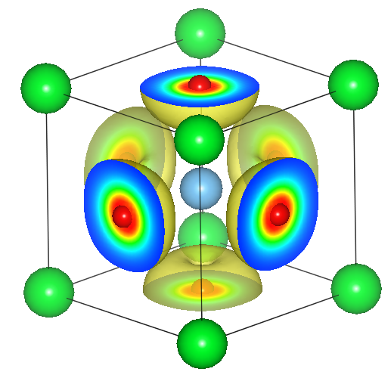
Introduction
Complex Oxide Perovskite Semiconductors; Crystals of the form ABO₃
A = Mono-, Di- or Trivalent element; Li, K, Mg, Ca, Sr, Ba, Sc, Y, La, Gd
B = Transition Metal cation; Ti, Zr, Hf, Y, Nb, Ta or; Al, Ga, In
Implications?
Explaining experimental results using fundamental theory.
Novel electronic materials.
Transparent conductors; Wide Band-Gap Semiconductors.
SrTiO₃
Valence band
maximum

Slide 3
Methods
We wish to solve the many-electron quantum mechanical equations for the electronic structure of solids.
Hartree-Fock (HF)
The many-electron wavefuntion is written as an anti-symmetric linear combination of single electron wavefunctions.
Density Functional Theory (DFT)
Replaces the many-electron problem with a single-particle in an effective potential.
1998 Nobel Prize awarded to Walter Kohn for his work on DFT.
Hybrid Functionals
Heyd-Scuseria-Ernzerhof (HSE)
Mixes both HF and DFT exchange potential to give a more accurate description of the electronic structure.

Slide 4
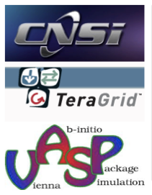
Methods
Vienna Ab-initio Simulation Package (VASP) code
A self-consistent iterative method which works to minimise the energy of the system by filling up electron bands and relaxing the lattice constant in turn
Solves the quantum mechanical Schrödinger equation.
The calculation uses First Principle methods and so no empirical input parameters are needed.
High Performance Computing
California NanoSystems Institute (CNSI), UCSB.
Lattice, Guild and Knot clusters.
Lonestar Cluster, Texas Advanced Computing Center, U Texas.
Computer Programming
Linux, bash, VI, XMGrace

Slide 5
Results I
SrHfO₃
Band Structure Plot
Comparisons using GGA (General Gradient Approximation)
SrTiO₃
a = 0.4142 nm ; E_{g} = 3.70 eV
SrZrO₃
a = 0.3948 nm ; E_{g} = 1.65 eV
a = 0.4194 nm ; E_{g} = 3.18 eV

Slide 6
Results II
SrHfO₃
Band Structure Plot
Comparisons using HSE
(Heyd-Scuseria-Ernzerhof )
SrTiO₃
a = 0.4109 nm ; E_{g} = 5.30 eV
SrZrO₃
a = 0.3905 nm ; E_{g} = 3.33 eV
a = 0.4142 nm ; E_{g} = 4.88 eV

Slide 7
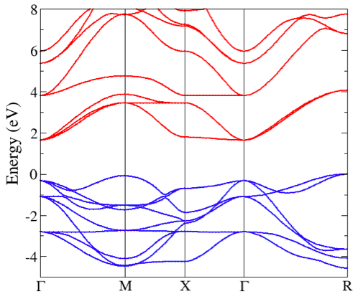
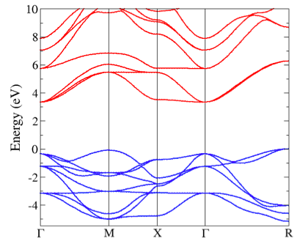
Results III
HSE vs. GGA
Accepted experimental values
a = 0.3905 nm; E_{g} = 3.25 eV
SrTiO₃ using GGA
SrTiO₃ using HSE
a = 0.3948 nm; E_{g} = 1.65 eV
a = 0.3905 nm ; E_{g} = 3.33 eV

Slide 8
Results IV
Lattice Constants and Indirect R-Γ band gaps, using GGA and HSE
On using HSE we get band gap widening of 1.54 ± 0.16 eV
Crystal | a (nm) [GGA] | a (nm) [HSE] | E_{g} (eV) [GGA] | E_{g} (eV) [HSE] | E_{g} diff (eV)
BaTiO₃ | 0.4038 | 0.3993 | 1.54 | 3.18 | 1.64
BaZrO₃ | 0.4251 | 0.4228 | 2.99 | 4.51 | 1.51
CaTiO₃ | 0.3896 | 0.3851 | 1.70 | 3.41 | 1.71
GdAlO₃ | 0.3726 | 0.3684 | 2.90 | 4.33 | 1.43
GdGaO₃ | 0.3843 | 0.3796 | 2.81 | 4.23 | 1.42
LaAlO₃ | 0.3810 | 0.3777 | 3.49 | 4.89 | 1.39
LaGaO₃ | 0.3928 | 0.3874 | 3.34 | 4.75 | 1.41
MgTiO₃ | 0.3851 | 0.3800 | 1.60 | 3.18 | 1.58
ScAlO₃ | 0.3646 | 0.3606 | 1.42 | 2.86 | 1.44
SrTiO₃ | 0.3948 | 0.3905 | 1.65 | 3.33 | 1.69
SrZrO₃ | 0.4194 | 0.4142 | 3.18 | 4.88 | 1.70
YAlO₃ | 0.3718 | 0.3681 | 2.80 | 4.36 | 1.56

Slide 9
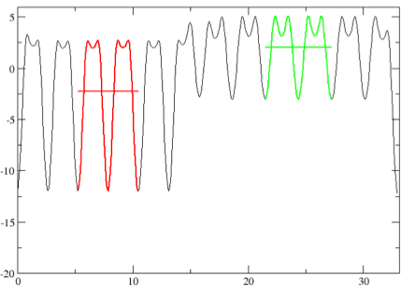
Results VI
Band Alignment Calculations;
Gives a Valence Band Offset of 0.44 eV
LaAlO₃-SrTiO₃
Electrostatic Potential, V
Displacement, x

Slide 10
Results VII
The Valence Band Offset is given by
where VBM_{i} is the Valance Band Maximum of material i, and is the Averaged Electrostatic Potential in the bulk region of an interface calculation.
SrTiO₃
SrZrO₃
0.98 eV
Conduction Band
Eg = 4.88 eV
Eg = 3.33 eV
Valence Band
0.57 eV

Slide 11
Summary and Conclusions
The electronic bandstructure of cubic perovskites were determined from first principles.
The valence bands of oxide perovskite are composed mostly of oxygen p-states.
The conduction bands are determined by the B-cation orbitals.
The use of hybrid functionals increase the band gaps by 1.54±0.16 eV.
Most of the band offsets are determined by the conduction bands.

Slide 12
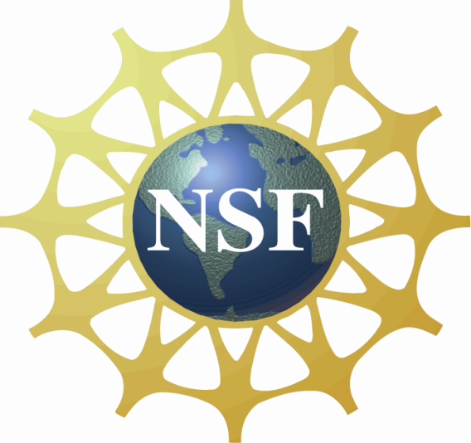
Acknowledgements
My supervisor Dr. Anderson Janotti and faculty advisor Prof. Chris Van de Walle
Daniel Steiauf, John Lyons, Cyrus Dreyer, Luke Gordon and all the other members of the Van de Walle Computational Materials Group.
The School of Physics, The University of Dublin, Trinity College and the SFI.

Slide 13
Thank you!

