Slide 1

The Approximation of
Generalized Log-aesthetic Curves with Quintic Bezier/Trigo Bezier Curves
R.U. Gobithaasan ^{1, a} , Diya’ J. Albayari^{1,b} ,Kenjiro T. Miura ^{2,c}
¹ School of Informatics & Applied Mathematics, University Malaysia Terengganu.
² Shizuoka University, Japan.

Slide 2

Contents
1. Standard Bezier curves and its fairness metric
2. A family of high quality curves: Log Aesthetic Curves
3. Approximation methods with curvature error measures
4. Results and Discussion
5. Conclusion & Future work

Slide 3
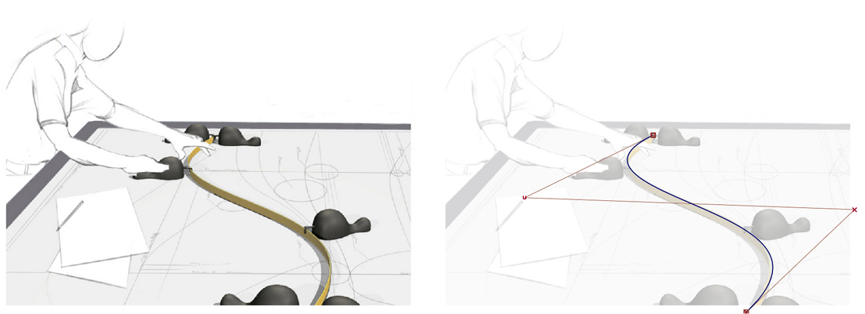
CONVENTIONAL DESIGN AND BEZIER CURVES

Slide 4
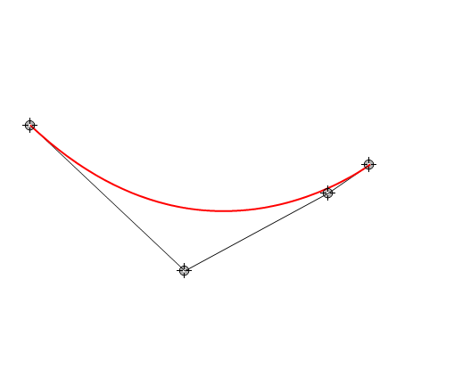
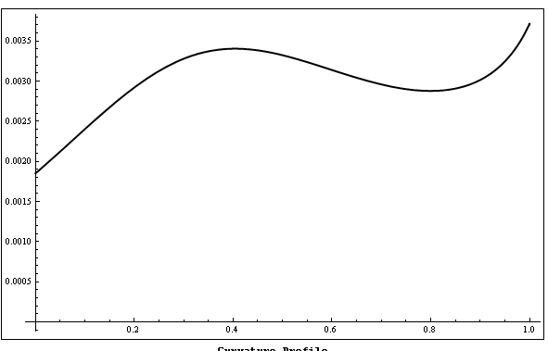
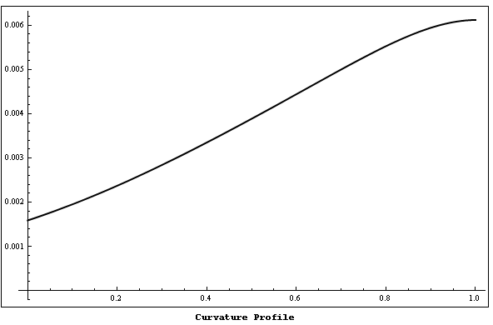
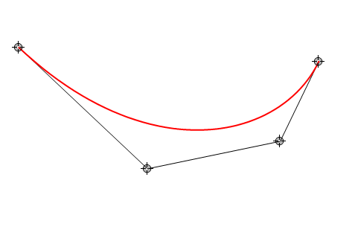
Fairing Bezier Curves

Slide 5
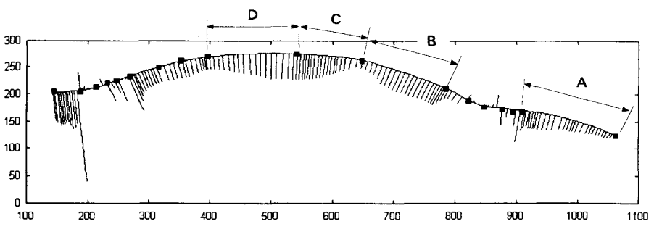
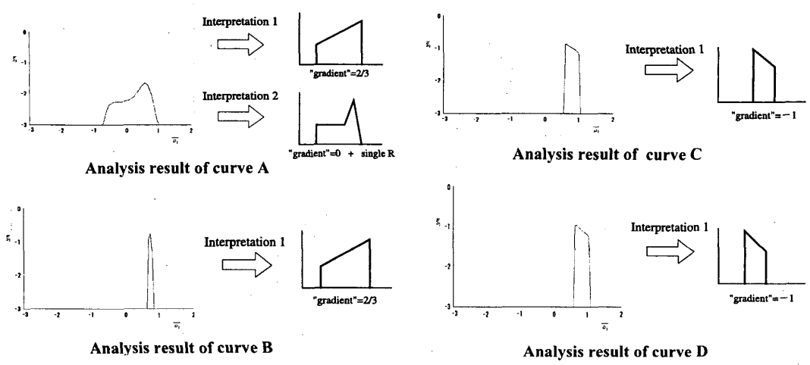
Logarithmic Distribution Diagram of Curvature (LDDC)

Slide 6
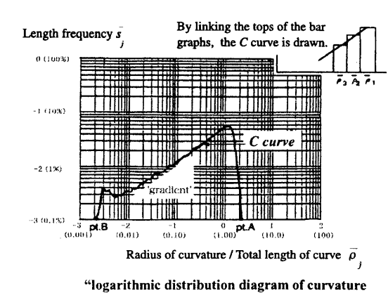
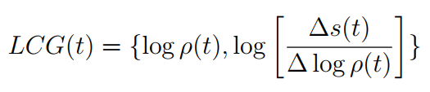
What makes an industrial product aesthetic?
Slope = α
Self affinity
(Harada et al, 1999)

Slide 7
Japanese Design Vs European Design
・David and F355
Divergent
・Basara and Celica
Convergent
Celica (top) and F355(bottom)
David (left) and Basara (right)
Kanaya et. al, Proc. VSMM2003, 2003, pp 289-296. Computer-Aided Design & Applications

Slide 8
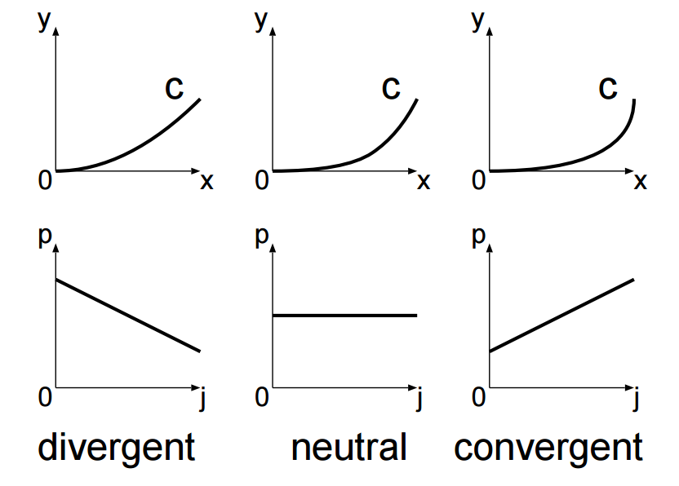
LDDC=Logarithmic Curvature Histogram
(Kanaya et al, 2003)

Slide 9
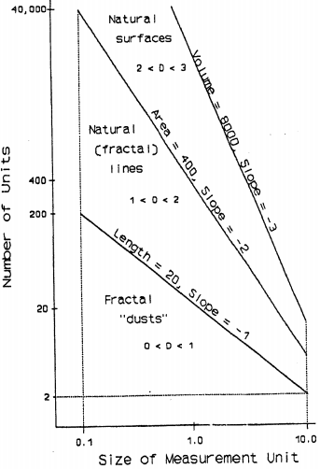
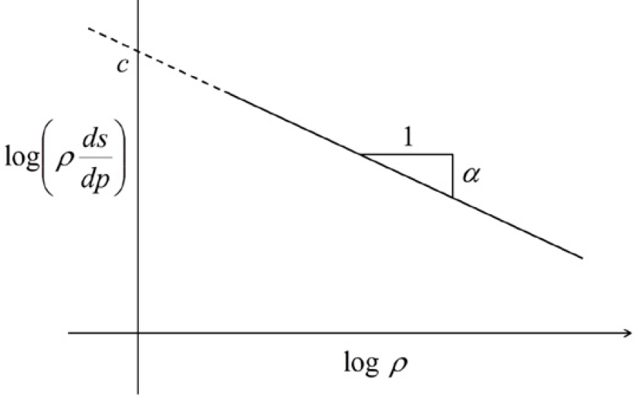
LAC derivation from LCH
Lorimer et al, 1994
Miura et al, 2005

Slide 10
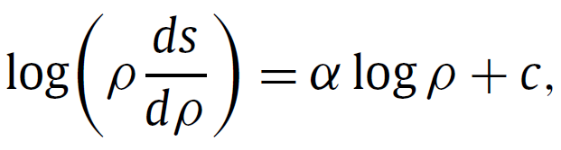
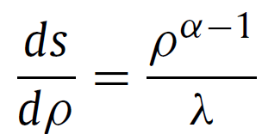
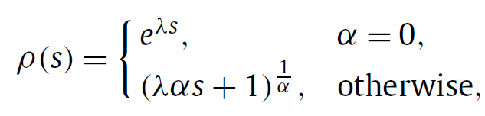
Aesthetic Curves

Slide 11
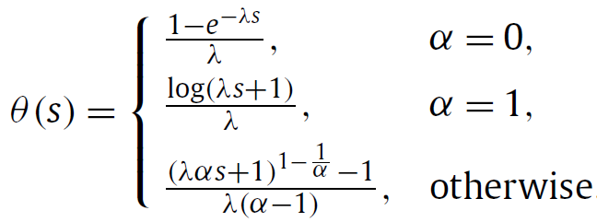
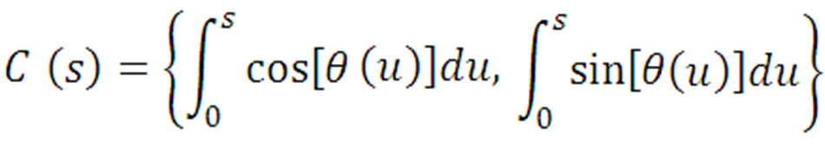
Log-Aesthetic Curves
Extensionality
Roundness
Monotone Curvature
Higher Order Vs Locality
Self affinity (curve generator)=
Extensionality +Two parameter
Interpolating Splines: Which is the fairest of them all?
Raph Levien and Séquin (2009)

Slide 12
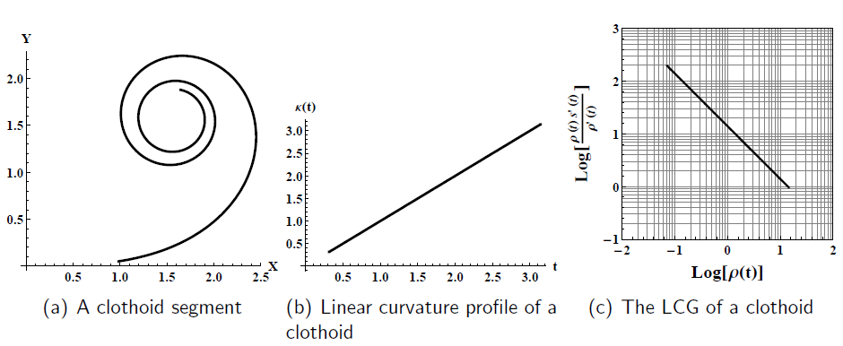
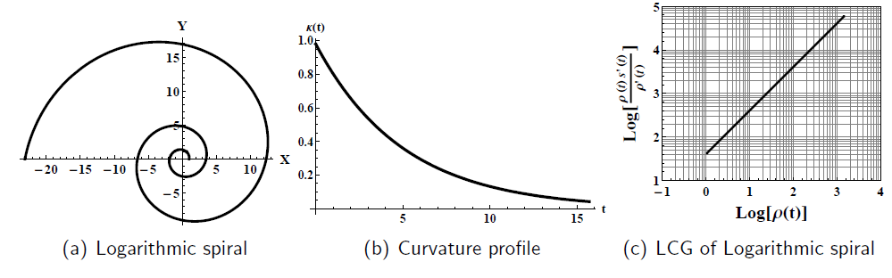
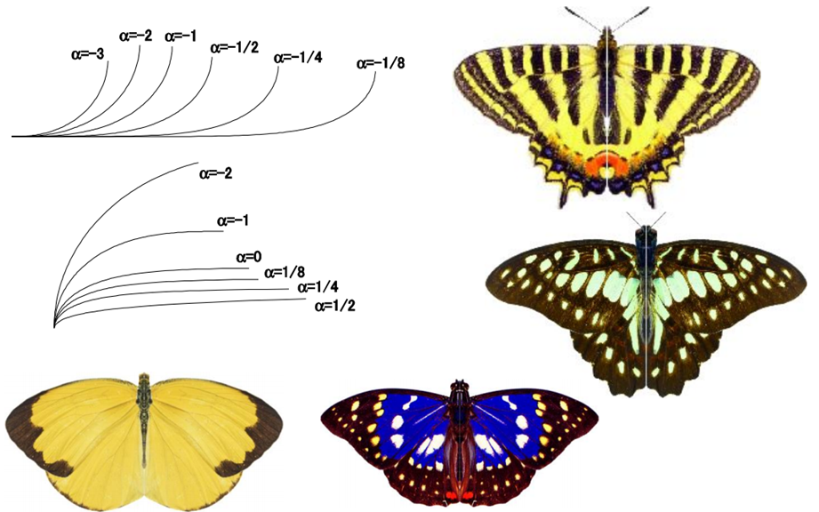
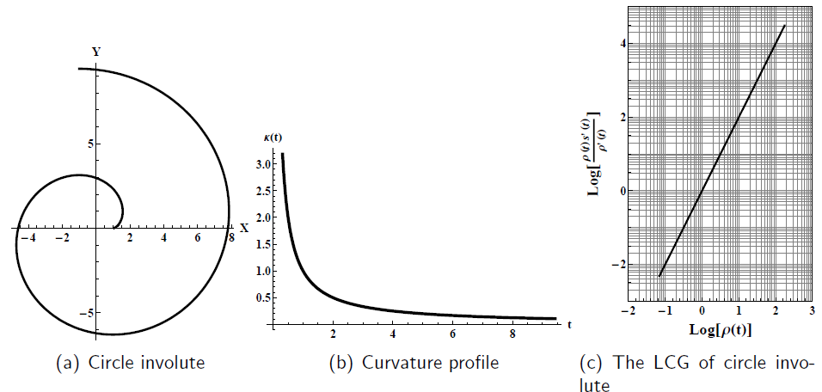
Some famous spirals
Clothoid curve α= -1
Nielsen’s spiral α= 0
Logarithmic spiral α=1
Circle involute α= 2

Slide 13
Curves for Design
Quasi-Aesthetic curves
GCS
GLAC
Conventional Curves
Bézier
B-spline
NURBS
fairing process
Constrained
Bezier Spiral
Class A Bézier
Log-aesthetic curve
Logarithmic spiral
Clothoid
Neilsen’s spiral
Circle involute

Slide 14
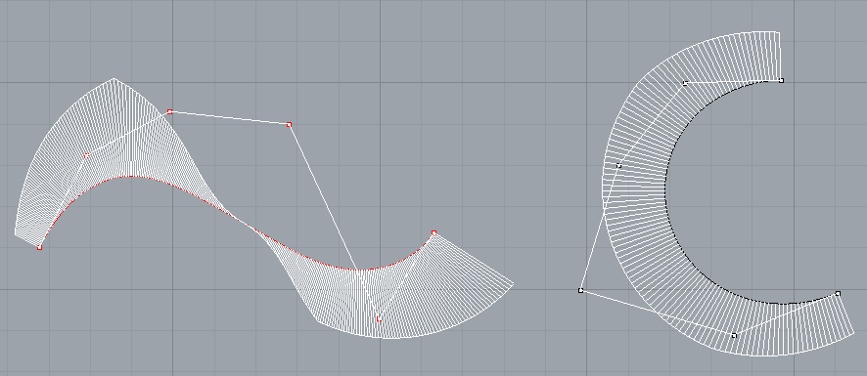
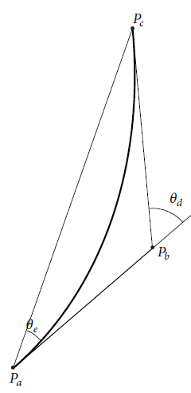
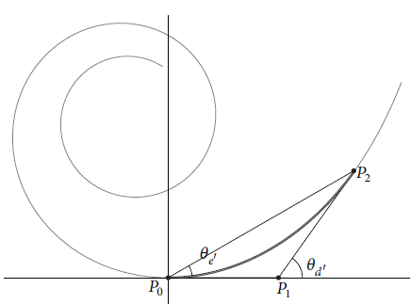
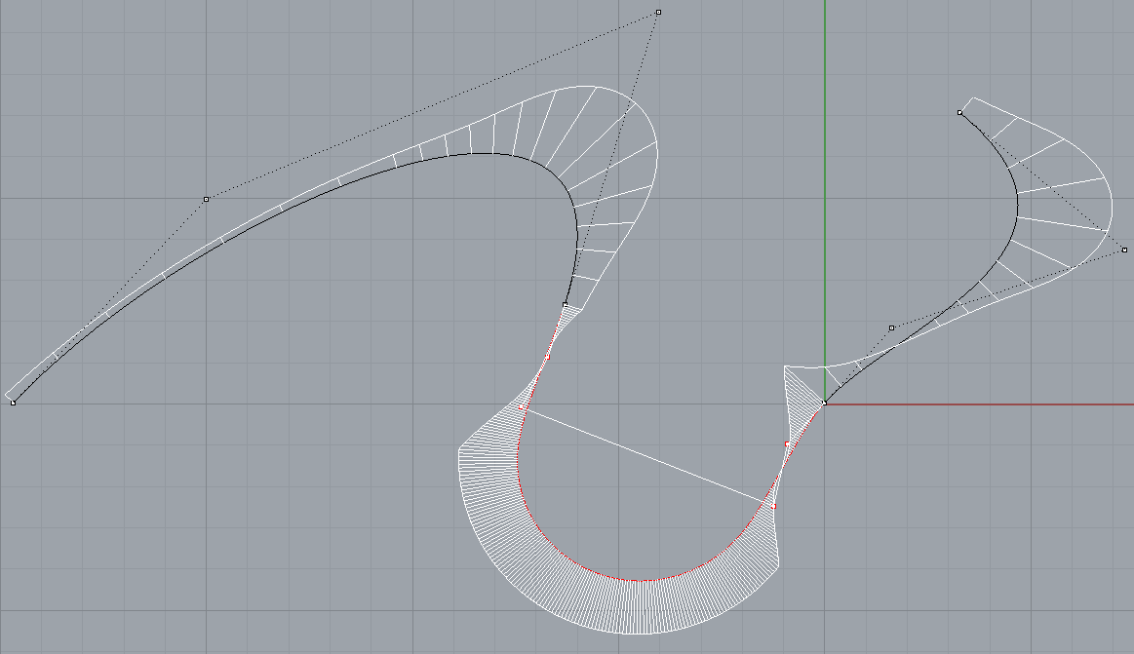
Drawing LACs with 3/4/6 control points

Slide 15

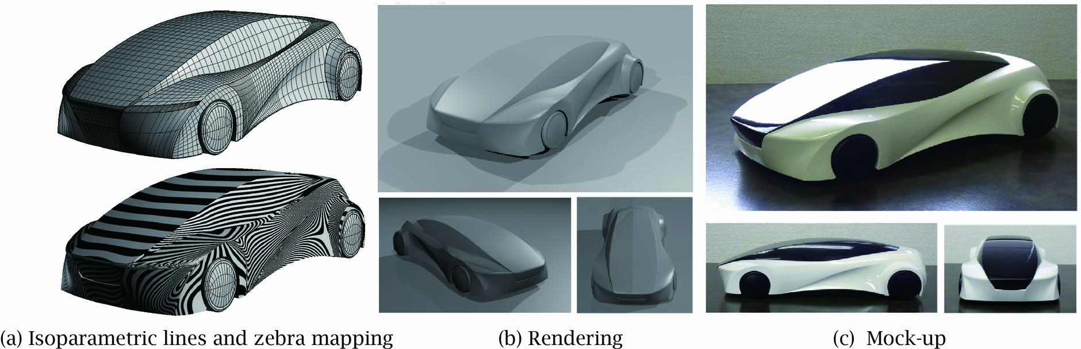
LAC as plugin for Rhino 3D

Slide 16
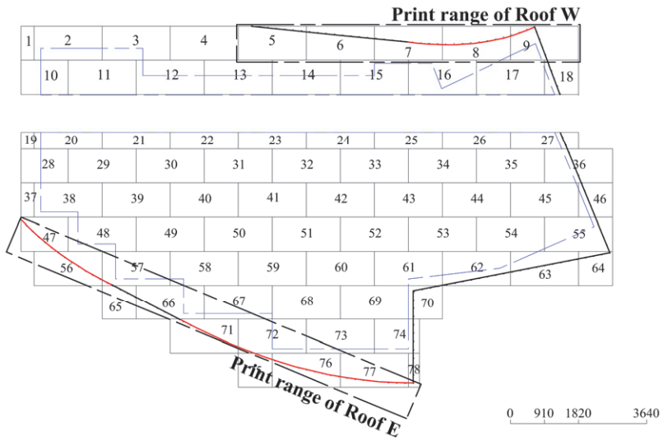
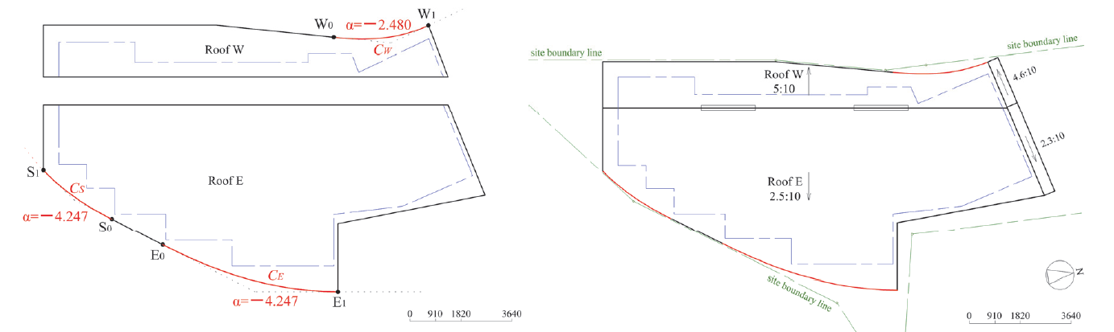
House Design by Prof. Toshitomo Suzuki ( Mukogawa Women's Uni.)

Slide 17
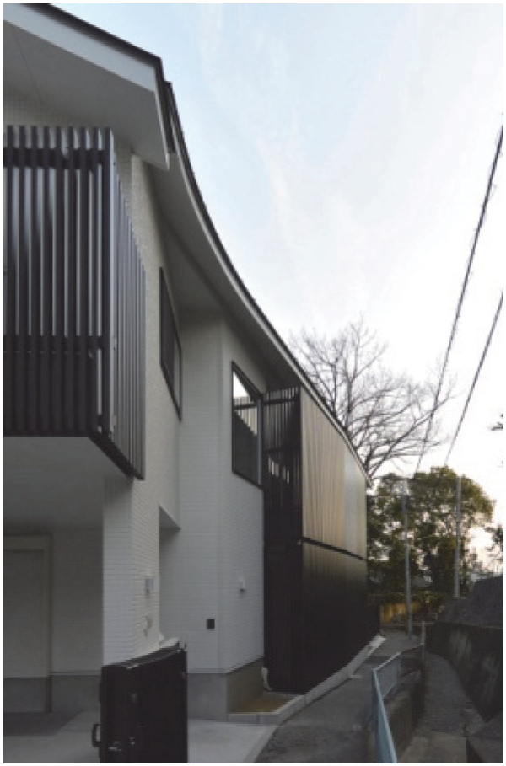
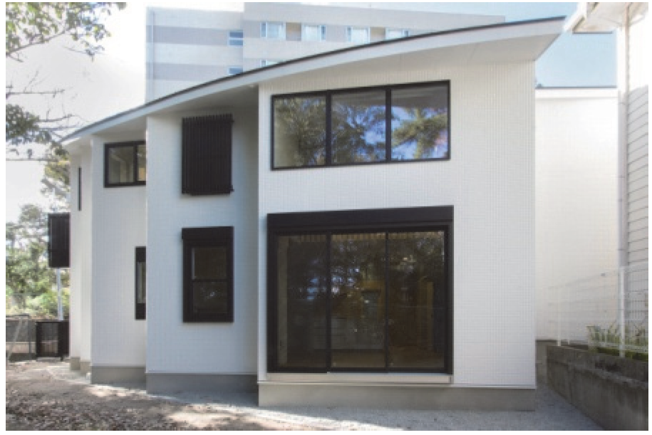
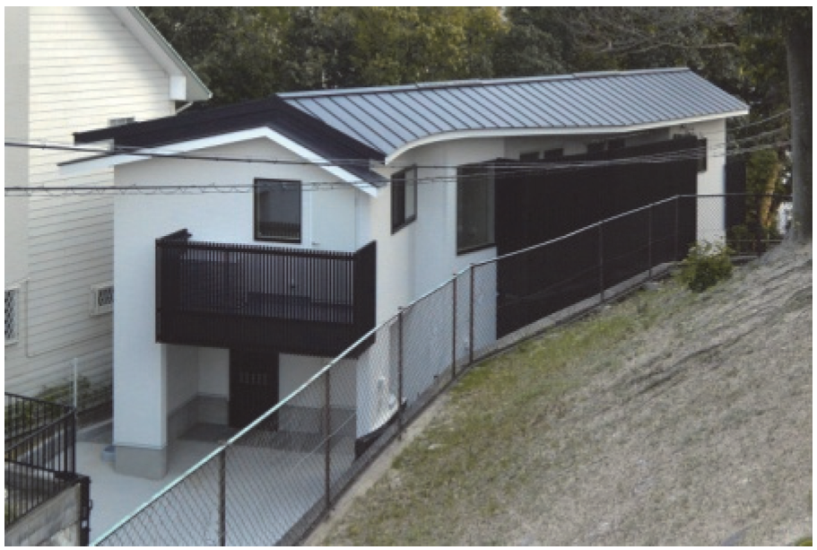

Slide 18
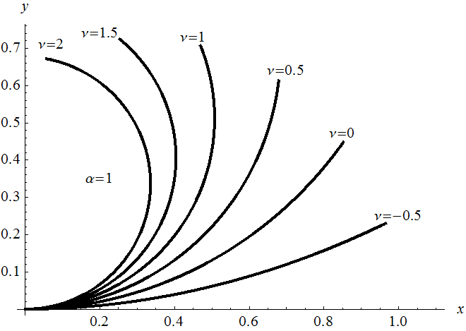

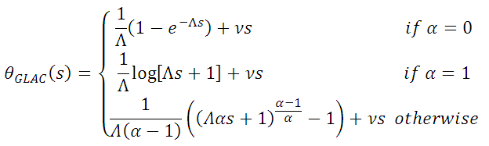


GLAC=
Extra shape parameter$ν$ + LA curves

Slide 19
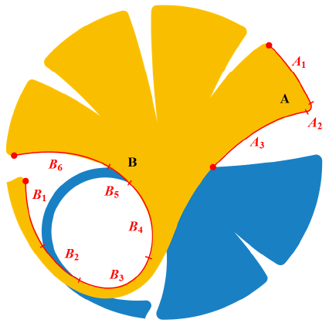
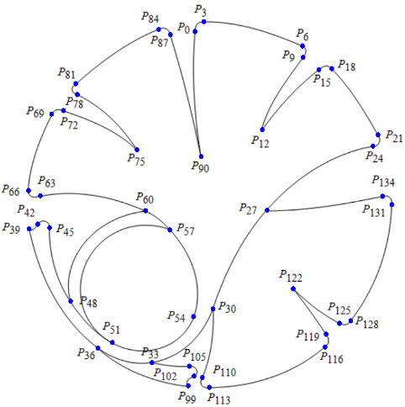
G1 GLAC
Generated logo using GLAC satisfying G¹ continuity.

Slide 20
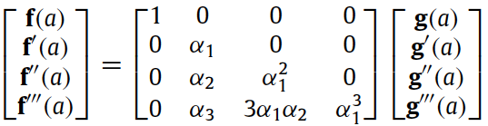
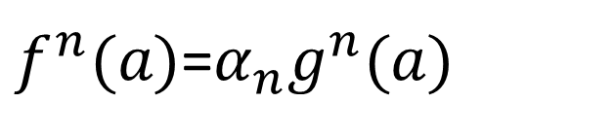
Approximation Idea: G^{n=3} Approximation
$f^{n}(a)$=$α_{n}g^{n}(a)$
Bezier
GLAC

Slide 21
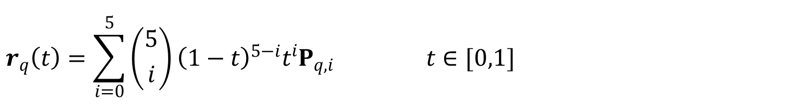
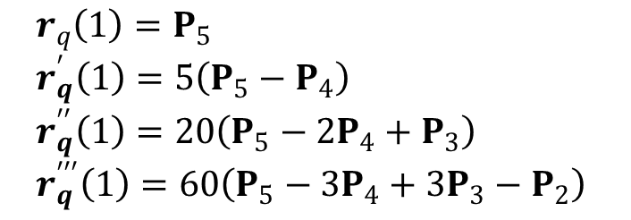
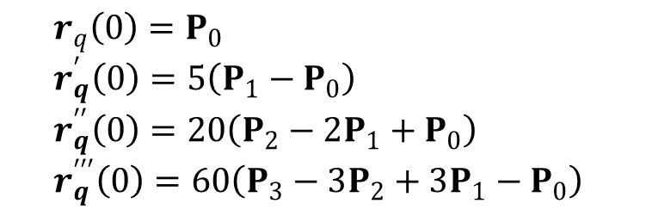
Quintic Bezier
$$r_{q}\left(t\right)=\sum_{i=0}^{5}{\left({5 \atop i}\right){\left(1−t\right)}^{5−i}t^{i}P_{q,i}} t∈[0,1]$$
where derivatives of at endpoints
$$r_{q}\left(0\right)=P_{0} \\ r_{q}^{′}\left(0\right)=5\left(P_{1}−P_{0}\right) \\ r_{q}^{′′}\left(0\right)=20\left(P_{2}−2P_{1}+P_{0}\right) \\ r_{q}^{′′′}\left(0\right)=60\left(P_{3}−3P_{2}+3P_{1}−P_{0}\right)$$
$$r_{q}\left(1\right)=P_{5} \\ r_{q}^{′}\left(1\right)=5\left(P_{5}−P_{4}\right) \\ r_{q}^{′′}\left(1\right)=20\left(P_{5}−2P_{4}+P_{3}\right) \\ r_{q}^{′′′}\left(1\right)=60\left(P_{5}−3P_{4}+3P_{3}−P_{2}\right)$$

Slide 22
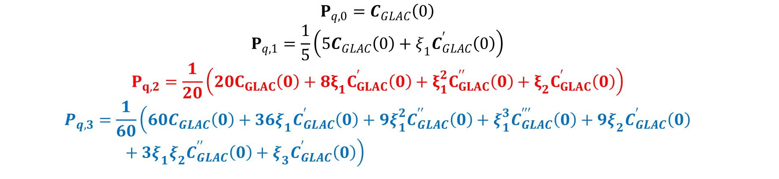
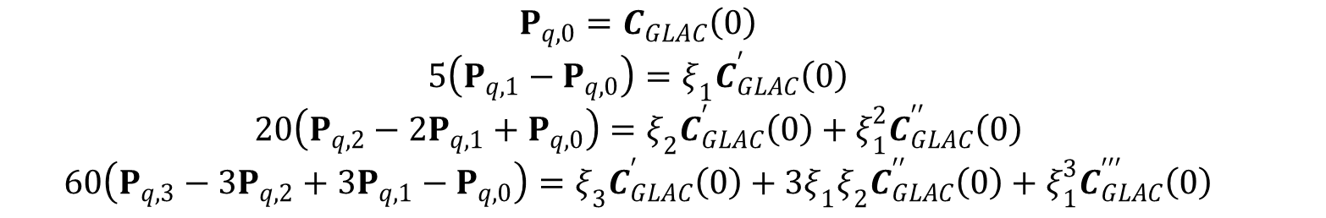
At Start point (t=0)
$$P_{q,0}=C_{GLAC}\left(0\right)$$ $$5\left(P_{q,1}−P_{q,0}\right)=ξ_{1}C_{GLAC}^{′}\left(0\right)$$ $$20\left(P_{q,2}−2P_{q,1}+P_{q,0}\right)=ξ_{2}C_{GLAC}^{′}\left(0\right)+ξ_{1}^{2}C_{GLAC}^{′′}\left(0\right)$$ $$60\left(P_{q,3}−3P_{q,2}+3P_{q,1}−P_{q,0}\right)=ξ_{3}C_{GLAC}^{′}\left(0\right)+3ξ_{1}ξ_{2}C_{GLAC}^{′′}\left(0\right)+ξ_{1}^{3}C_{GLAC}^{′′′}\left(0\right)$$
$$P_{q,0}=C_{GLAC}\left(0\right)$$ $$P_{q,1}=\frac{1}{5}\left(5C_{GLAC}\left(0\right)+ξ_{1}C_{GLAC}^{′}\left(0\right)\right)$$ $$P_{q,2}=\frac{1}{20}\left(20C_{GLAC}\left(0\right)+8ξ_{1}C_{GLAC}^{′}\left(0\right)+ξ_{1}^{2}C_{GLAC}^{′′}\left(0\right)+ξ_{2}C_{GLAC}^{′}\left(0\right)\right)$$ $$P_{q,3}=\frac{1}{60}\left(60C_{GLAC}\left(0\right)+36ξ_{1}C_{GLAC}^{′}\left(0\right)+9ξ_{1}^{2}C_{GLAC}^{′′}\left(0\right)+ξ_{1}^{3}C_{GLAC}^{′′′}\left(0\right)+9ξ_{2}C_{GLAC}^{′}\left(0\right)+3ξ_{1}ξ_{2}C_{GLAC}^{′′}\left(0\right)+ξ_{3}C_{GLAC}^{′}\left(0\right)\right)$$

Slide 23
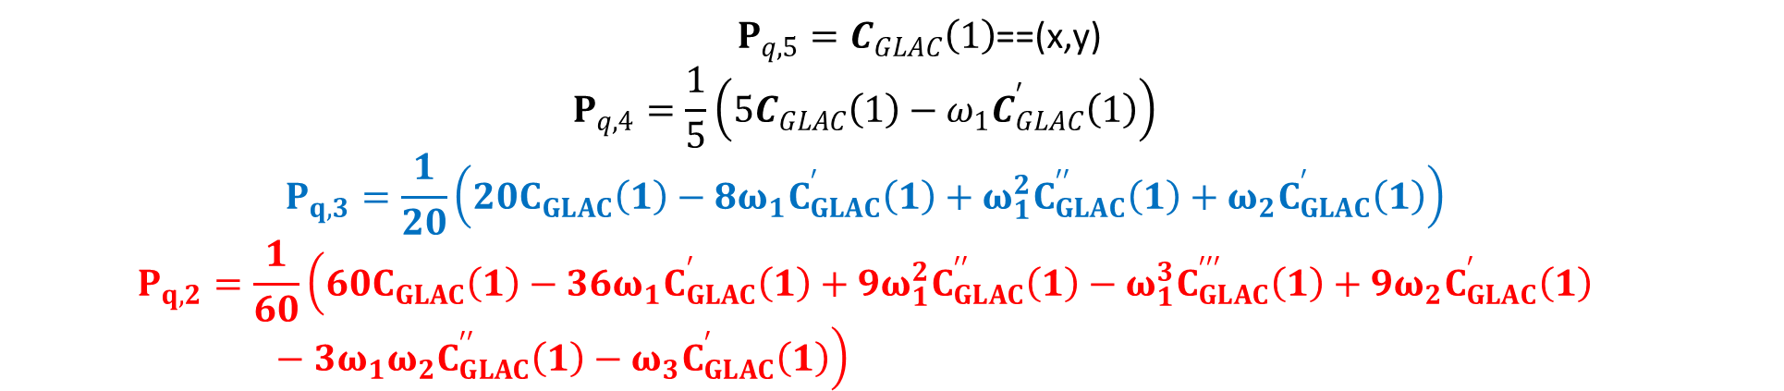
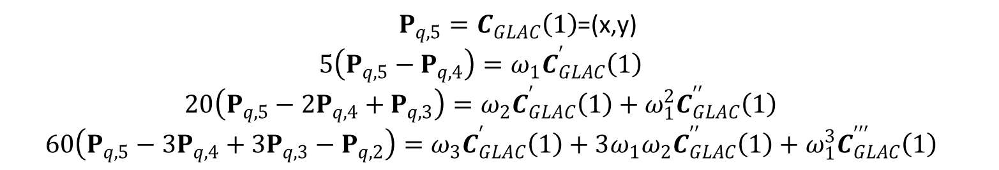
At end point (t=1)
$P_{q,5}=C_{GLAC}\left(1\right)$=(x,y) $$5\left(P_{q,5}−P_{q,4}\right)=ω_{1}C_{GLAC}^{′}\left(1\right)$$ $$20\left(P_{q,5}−2P_{q,4}+P_{q,3}\right)=ω_{2}C_{GLAC}^{′}\left(1\right)+ω_{1}^{2}C_{GLAC}^{′′}\left(1\right)$$ $$60\left(P_{q,5}−3P_{q,4}+3P_{q,3}−P_{q,2}\right)=ω_{3}C_{GLAC}^{′}\left(1\right)+3ω_{1}ω_{2}C_{GLAC}^{′′}\left(1\right)+ω_{1}^{3}C_{GLAC}^{′′′}\left(1\right)$$
$P_{q,5}=C_{GLAC}\left(1\right)$==(x,y) $$P_{q,4}=\frac{1}{5}\left(5C_{GLAC}\left(1\right)−ω_{1}C_{GLAC}^{′}\left(1\right)\right)$$ $$P_{q,3}=\frac{1}{20}\left(20C_{GLAC}\left(1\right)−8ω_{1}C_{GLAC}^{′}\left(1\right)+ω_{1}^{2}C_{GLAC}^{′′}\left(1\right)+ω_{2}C_{GLAC}^{′}\left(1\right)\right)$$ $$P_{q,2}=\frac{1}{60}\left(60C_{GLAC}\left(1\right)−36ω_{1}C_{GLAC}^{′}\left(1\right)+9ω_{1}^{2}C_{GLAC}^{′′}\left(1\right)−ω_{1}^{3}C_{GLAC}^{′′′}\left(1\right)+9ω_{2}C_{GLAC}^{′}\left(1\right)−3ω_{1}ω_{2}C_{GLAC}^{′′}\left(1\right)−ω_{3}C_{GLAC}^{′}\left(1\right)\right)$$

Slide 24
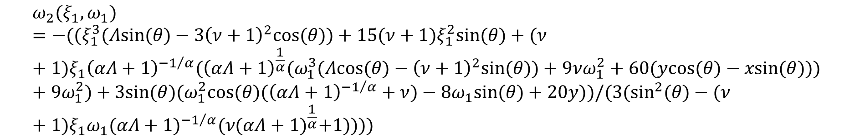
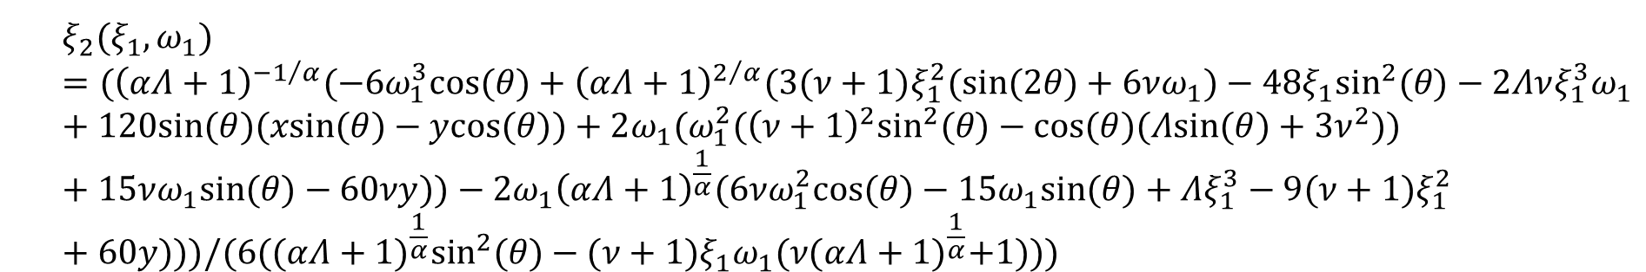
GLAC satisfying endpoint Geometric continuity
$$ξ_{2}(ξ_{1},ω_{1})=({\left(αΛ+1\right)}^{{−1}/α}(−6ω_{1}^{3}cos(θ)+{\left(αΛ+1\right)}^{2/α}(3(ν+1)ξ_{1}^{2}(sin(2θ)+6νω_{1})−48ξ_{1}\sin^{2}(θ)−2Λνξ_{1}^{3}ω_{1}+120sin(θ)(xsin(θ)−ycos(θ))+2ω_{1}(ω_{1}^{2}({\left(ν+1\right)}^{2}\sin^{2}(θ)−cos(θ)(Λsin(θ)+3ν^{2}))+15νω_{1}sin(θ)−60νy))−2ω_{1}{\left(αΛ+1\right)}^{\frac{1}{α}}(6νω_{1}^{2}cos(θ)−15ω_{1}sin(θ)+Λξ_{1}^{3}−9(ν+1)ξ_{1}^{2}+60y)))/(6({(αΛ+1)}^{\frac{1}{α}}\sin^{2}(θ)−(ν+1)ξ_{1}ω_{1}(ν{(αΛ+1)}^{\frac{1}{α}}+1)))$$
$$ω_{2}(ξ_{1},ω_{1})=−((ξ_{1}^{3}(Λsin(θ)−3{\left(ν+1\right)}^{2}cos(θ))+15(ν+1)ξ_{1}^{2}sin(θ)+(ν+1)ξ_{1}{\left(αΛ+1\right)}^{{−1}/α}({\left(αΛ+1\right)}^{\frac{1}{α}}(ω_{1}^{3}(Λcos(θ)−{\left(ν+1\right)}^{2}sin(θ))+9νω_{1}^{2}+60(ycos(θ)−xsin(θ)))+9ω_{1}^{2})+3sin(θ)(ω_{1}^{2}cos(θ)({\left(αΛ+1\right)}^{{−1}/α}+ν)−8ω_{1}sin(θ)+20y))/(3(\sin^{2}(θ)−(ν+1)ξ_{1}ω_{1}{(αΛ+1)}^{{−1}/α}(ν{(αΛ+1)}^{\frac{1}{α}}+1))))$$

Slide 25
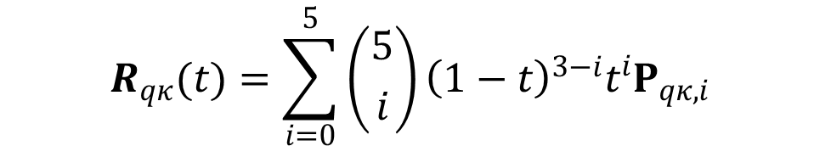
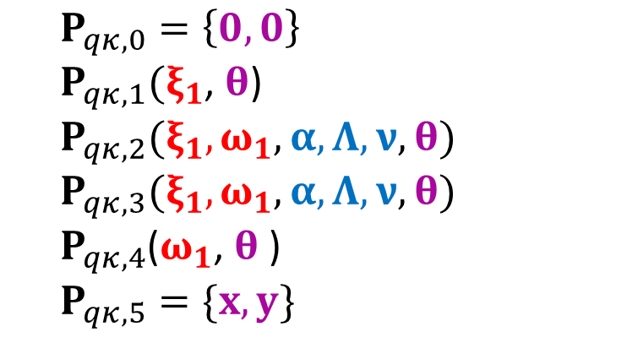
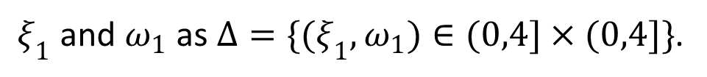
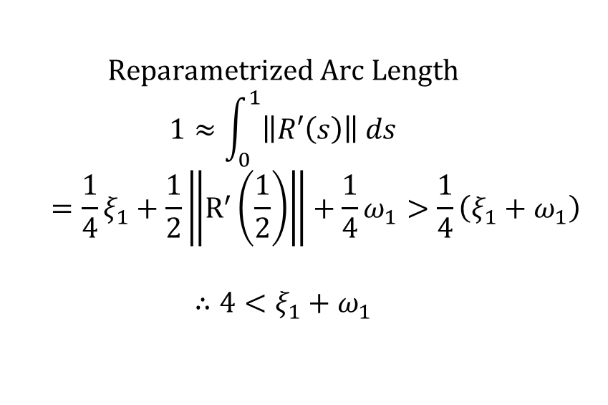

Control points of Quintic Bezier Approximation
$$R_{qκ}(t)=\sum_{i=0}^{5}{\left({5 \atop i}\right){\left(1−t\right)}^{3−i}t^{i}P_{qκ,i}}$$
Lower bound
$$0>ξ_{1}+ω_{1}$$
Upper bound
$$Reparametrized Arc Length$$ $$1≈\int_{0}^{1}{\left\|R′\left(s\right)\right\| ds}$$ $$=\frac{1}{4}ξ_{1}+\frac{1}{2}\left\|R^{′}\left(\frac{1}{2}\right)\right\|+\frac{1}{4}ω_{1}>\frac{1}{4}\left(ξ_{1}+ω_{1}\right)$$ $$∴4<ξ_{1}+ω_{1}$$
$$P_{qκ,0}=\left\{0,0\right\}$$ $P_{qκ,1}(ξ_{1}$, $θ$) $$P_{qκ,2}(ξ_{1}, ω_{1}, α,Λ,ν,θ)$$ $$P_{qκ,3}(ξ_{1}, ω_{1}, α,Λ,ν,θ)$$ $P_{qκ,4}$($ω_{1}$, $θ$ ) $$P_{qκ,5}=\{x,y\}$$
$ξ_{1}$ and $ω_{1}$ as ${Δ=\{(ξ}_{1},ω_{1})∈(0,4]×(0,4]\}$.

Slide 26



Finding Optimal $ξ_{1} \& ω_{1}$ with curvature errors
$$ϵ={}_{s∈[0,1]}^{max} \frac{\left|κ_{r_{q}}\left(s\right)−κ_{C}(s)\right|}{max\{{|κ}_{C}\left(s\right)|,1\}}$$
$κ_{r_{q}}\left(s\right)$ is the curvature function for Bezier
$κ_{C}\left(s\right)$ is the curvature function of the GLAC
Cross & Cripps, 2012/2016
Lu, 2013
Lu & Xi, 2016

Slide 27

The algorithm
Notes:
1. for , where is the total length of the curve and a(t) is arc length.
2. in our new error measure gained from interpolating curvature nodes while in Cross and Cripps measure obtained from the traditionally formidable size of computations method .

Slide 28

Results: Normalized Arc Length
 | Cubic Bezier |  |  |  |  | Cubic Trigonometric Bezier |  |  |  |  | Quintic Bezier
(α, Λ, ν) | ($ξ_{1},ω_{1})$ | # Itr | $$\dot{ε}$$ | Time (s) |  | ($ξ_{1},ω_{1})$ | # Itr | $$\dot{ε}$$ | Time (s) |  | ($ξ_{1},ω_{1})$ | # Itr | $$\dot{ε}$$ | Time (s)
(-1,0.5,1) | (1,1) | 0 | 0.596104 | 0.3906 |  | (1,1) | 0 | 0.003419 | 0.8281 |  | (1,1) | 0 | 0.000920 | 0.4688
 | (0.985,1.140) | 1 | 0.025942 | 0.8125
(0,0.5,0.5) | (1,1) | 0 | 0.394663 | 0.4063 |  | (1,1) | 0 | 0.007401 | 0.8438 |  | (1,1) | 0 | 0.000098 | 0.5781
 | (0.955,1.113) | 1 | 0.008084 | 0.8594
(0.7,-0.6,0.1) | (1,1) | 0 | 0.634895 | 0.5000 |  | (1,1) | 0 | 0.083813 | 0.8438 |  | (1,1) | 0 | 0.003956 | 0.4219
 | (1.242,0.862) | 1 | 0.017444 | 0.8594 |  | (0.982,0.970) | 1 | 0.008955 | 1.8594
(1,-0.5,0.3) | (1,1) | 0 | 0.631386 | 0.3594 |  | (1,1) | 0 | 0.080811 | 0.9844 |  | (1,1) | 0 | 0.003997 | 0.4063
 | (1.202,0.902) | 1 | 0.025608 | 0.7031 |  | (0.981,0.973) | 1 | 0.006138 | 1.8906
(2,-0.1,0.2) | (1,1) | 0 | 0.34501 | 0.4063 |  | (1,1) | 0 | 0.004157 | 0.8906 |  | (1,1) | 0 | 0.000143 | 0.6563
 | (1.056,1.007) | 1 | 0.007432 | 0.7969
Laptop spec: Intel Core i3 2.4GHz and 2GB RAM
Tol=0.05 for CAD implementation ( as proposed in Cross & Cripps (2012)

Slide 29

Results: various arc lengths
 |  | Cubic Bezier |  |  |  |  | Cubic Trigonometric Bezier |  |  |  |  | Quintic Bezier
(α, Λ, ν) | S | ($ξ_{1},ω_{1})$ | # Itr | $$\dot{ε}$$ | Time (s) |  | ($ξ_{1},ω_{1})$ | # Itr | $$\dot{ε}$$ | Time (s) |  | ($ξ_{1},ω_{1})$ | # Itr | $$\dot{ε}$$ | Time (s)
(-1,0.2,-0.1) | 3 | (3,3) | 0 | 0.622259 | 0.3750 |  | (3,3) | 0 | 0.007819 | 0.8750 |  | (1,1) | 0 | 0.004575 | 0.3906
 |  | (2.337,4.473) | 1 | 0.016135 | 0.7344
(0,0.5,0.2) | 2 | (2,2) | 0 | 0.467113 | 0.3750 |  | (2,2) | 0 | 0.059382 | 0.8750 |  | (1,1) | 0 | 0.002166 | 0.3750
 |  | (1.733,2.525) | 1 | 0.019160 | 0.7656 |  | (1.948,1.971) | 1 | 0.005753 | 2.0625
(0.3,0.2,0.1) | 2 | (2,2) | 0 | 0.504361 | 0.3906 |  | (2,2) | 0 | 0.021884 | 0.8438 |  | (1,1) | 0 | 0.000625 | 0.4531
 |  | (1.953,2.312) | 1 | 0.032646 | 0.7656
(1,0.1,-0.3) | 3 | (3,3) | 0 | 0.2918 | 0.3750 |  | (3,3) | 0 | 0.013707 | 1.0313 |  | (1,1) | 0 | 0.000175 | 0.4219
 |  | (2.860,3.498) | 1 | 0.015333 | 0.7031
(2,0.3,-0.4) | 5 | (5,5) | 0 | 0.434436 | 0.3438 |  | (5,5) | 0 | 0.063259 | 0.9219 |  | (1,1) | 0 | 0.001594 | 0.3906
 |  | (2.554,8.865) | 1 | 0.022365 | 0.7031 |  | (4.367,4.663) | 1 | 0.015615 | 1.7813

Slide 30






GLAC (logarithmic spiral):
$$α=1,Λ=0.1,v=−0.3 and S=3$$

Slide 31






GLAC (circle involute):
$$α=2,Λ=0.1,v=−0.3 and S=3$$

Slide 32




GLAC (clothoid):
$$α=−1,Λ=0.5,v=1 and S=1$$

Slide 33
Conclusion & Future work
The proposed method takes lesser iteration with tol<0.05 as compared to Cross and Cripps’s or Lu’s error measure.
Optimal solution region conforming to GLAC’s shape factors.
Suitable condition/cases to subdivide GLAC to guarantee acceptable approximation.

Slide 34


