Slide 1
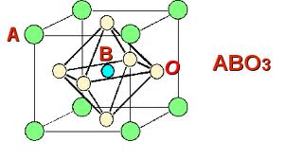
First-Principle Calculations of Oxide Perovskite Semiconductors
David-Alexander Robinson Sch.
Dr. Anderson Janotti
Prof. Chris Van de Walle
Computational Materials Group
Materials Research Laboratory, UCSB

Slide 2
Introduction
Complex Oxide Perovskite Semiconductors; Crystals of the form ABO₃
A = Mono-, Di- or Trivalent element; Li, K, Mg, Ca, Sr, Ba, Sc, Y, La, Gd
B = Transition Metal cation; Ti, Zr, Hf, Y, Nb, Ta or; Al, Ga, In
Implications?
Explaining experimental results using fundamental theory.
Novel electronic materials.
Transparent conductors; Wide Band-Gap Semiconductors.

Slide 3
Methods
Hybrid Functionals
Heyd-Scuseria-Ernzerhof (HSE)
Combines both Hartree-Fock and Density Functional Theory methods to give a more accurate result.
Vienna Ab-initio Simulation Package (VASP) code
An Iterative method.
VASP works to minimise the energy of the system by filling up electron bands and relaxing the lattice constant in turn
High Performance Computing
California NanoSystems Institute (CNSI), UCSB.
Ranger Cluster, Texas Advanced Computing Center, U Texas.

Slide 4
Results I
SrHfO₃
Band Structure Plot
Comparisons using GGA (General Gradient Approximation)
SrTiO₃
a = 0.414 nm
SrZrO₃
a = 0.395 nm
a = 0.419 nm

Slide 5
Results II
SrHfO₃
Band Structure Plot
Comparisons using HSE
(Heyd-Scuseria-Ernzerhof )
SrTiO₃
a = 0.414 nm
SrZrO₃
a = 0.395 nm
a = 0.419 nm

Slide 6
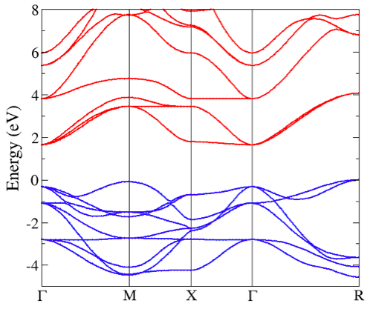
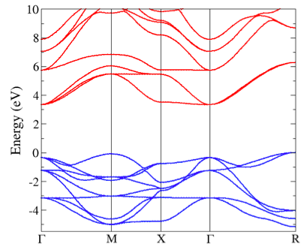
Results III
HSE vs. GGA
Accepted experimental values
a = 0.3905 nm; E_{g} = 3.25 eV
SrTiO₃ using GGA
SrTiO₃ using HSE
a = 0.39483 nm; E_{g} = 1.8 eV
a = 0.39046 nm ; E_{g} = 3.332 eV

Slide 7
Results IV
Lattice Constants and Indirect R-Γ band gaps, using GGA and HSE
On using HSE we get band gap widening of 1.5±0.2 eV *
crystal | a (nm) [GGA] | a (nm) [HSE] | E_{g} (eV) [GGA] | E_{g} (eV) [HSE] | E_{g} diff (eV)
BaTiO_3 | 0.40380 | 0.39934 | 1.5436 | 3.1847 | 1.6411
BaZrO_3 | 0.42506 | 0.42276 | 2.9927 | 4.5073 | 1.5146
CaTiO_3 | 0.38964 | 0.38511 | 1.7036 | 3.4088 | 1.7051
GdAlO_3 | 0.37256 | 0.36835 | 2.9004 | 4.3289 | 1.4285
GdGaO_3 | 0.38431 | 0.3796 | 2.8069 | 4.2252 | 1.4183
LaAlO_3 | 0.38098 | 0.37772 | 3.4934 | 4.8867 | 1.3933
LaGaO_3 | 0.39280 | 0.38738 | 3.3386 | 4.7459 | 1.4072
MgTiO_3 | 0.38510 | 0.38004 | 1.6005 | 3.1846 | 1.5841
ScAlO_3 | 0.36457 | 0.36063 | 2.2320 | 2.8631 | 0.6311
SrTiO_3 | 0.39483 | 0.39046 | 1.6465 | 3.3326 | 1.6861
SrZrO_3 | 0.41943 | 0.39049 | 3.1819 | 3.3171 | 0.1352
Y.AlO_3 | 0.37182 | 0.36814 | 2.8012 | 2.7757 | -0.0255

Slide 8
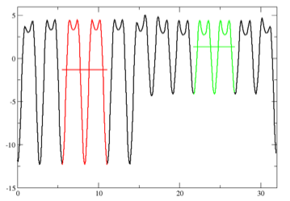
Results V
Band Alignment Calculations;
Gives a Valance Band Offset of 0.19 eV
LaAlO₃-GdAlO₃
Electrostatic Potential, V
Displacement, x

Slide 9
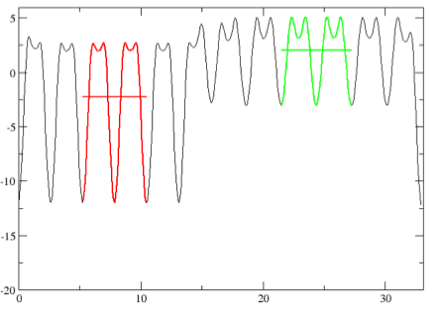
Results VI
Band Alignment Calculations;
Gives a Valance Band Offset of 0.44 eV
LaAlO₃-GdAlO₃
Electrostatic Potential, V
Displacement, x

